Slide 1
WEB SECURITY
Why every site you’ve ever visited is vulnerable
Notes:
By the way, don't use IPv6 (this is not quite as bad as it looks)

Slide 2
THIS TALK PROUDLY STOLEN FROM
https://www.owasp.org/index.php/Category:OWASP_Top_Ten_Project
https://www.troyhunt.com/owasp-top-10-for-net-developers-part-1/
https://stackoverflow.com

Slide 3
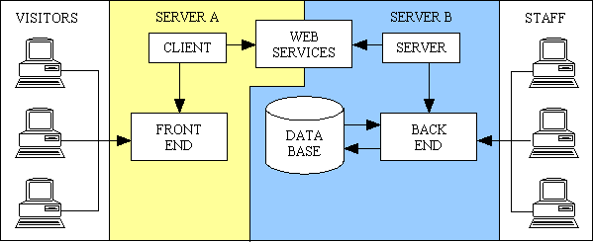
WHAT DOES A WEBSITE LOOK LIKE?
Notes:
So this is the structure of a website. Front end, back end, some HTTP in the middle, some JS on the front end, some databases on the backend.

Slide 4
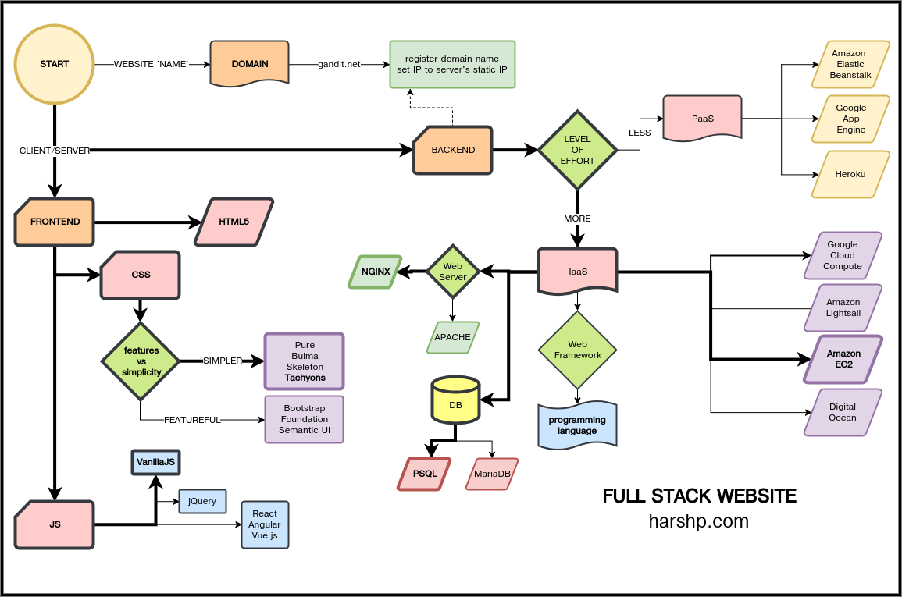
NO. ABSOLUTELY NOT.
Notes:
JS, Jquery, Vue, Angular because the intern from amazon, CSS, build systems for CSS, experimental web APIs, DNS, ARP caches, HTTP, HTTPS, I can go on. That’s just the front end.

Slide 5
WHERE DO THINGS GO WRONG?
Everywhere
any step in the chain can make you vulnerable

Slide 6
That’s not helpful.
OWASP has a top 10 list of things that go wrong.
it is non-exhaustive because an exhaustive document is impossible.
Injection
Authentication
Data Exposure
External Entities in XML
Access Controll
Misconfiguration
Cross-Site Scripting (XSS)
Deserialization
Vulnerabile Dependencies
Insufficient Logging
We don’t have time to go into detail, so this is just enough info to google what you need.

Slide 7
Tools
OWASP ZAP
Has quite a few false warnings
Easy to setup and use
Catches simple mistakes (missing headers)
Free and Open Source Software (FOSS)
Burp
I have no idea how to use it
Tests how your site responds to man-in-the-middle attacks
Community edition is very limited

Slide 8
Injection - SQL
Databases used for most data (usernames, passwords, emails, credit cards . . .)
Injection allows reading, modifying, and deleting data
Example:
sSQL = ‘SELECT password_hash FROM users WHERE username = “‘ + username + ‘“‘
database.query(sSQL)
If username is ‘blah“; SELECT email FROM users /*’, then you get all user emails
Use parameterized queries instead:
database.query(‘SELECT password_hash FROM users WHERE username = ?’, username)
Do this for ANY untrusted data (read: user input)
More info

Slide 9
SQL Injection Demo
Notes:
~/Programming/web/talk/injection

Slide 10
Injection - etc.
LDAP
Similar to SQL Injection
Can’t send parameterized queries, have to use escaping
XPath
Only a problem if you store sensitive info in XML files . . .
Again, used parameterized queries
JSON
Array.from (fixed in EMCA 5.0)
More exploits

Slide 11
2. Authentication - Hashing
Don’t store password at ALL (lots of passwords leaked because of 5. Access control)
Hash instead: one-way function
Salt hashes to prevent rainbow tables
Use random salt (hashcat demo)
Use latest algorithm from OWASP (currently Argon2)
Don’t roll your own encryption

Slide 12
2. Authentication - Sessions
Don’t send passwords across network more than necessary
Send temporary ‘session id’ instead
Don’t show session ID in url (not encrypted)
Set a timeout (idle and absolute)
Add a logout button
Don’t cache sensitive pages

Slide 13
2. Authentication - etc.
Brute-forcing: Limit attempts per second
Default passwords: Just no.
Bad password requirements
max length
limited list of characters or no unicode support
must be renewed (encourages reuse)
No 2FA or poor 2FA
Credential Stuffing (or, why Password Reuse is bad)

Slide 14
3. Data exposure
ENCRYPT YOUR DATA: at-rest and in-transit
Nowadays, browsers use TLS = Diffie-Hellman + Symmetric Encryption
Will mention again in 6. Misconfiguration
Without encryption, you’re handing your passwords and credit cards over to attackers
Enforce TLS with HTTP Strict Transport Security (HSTS)
(used to be) Common error: only encrypting login pages

Slide 15
4. XML External Entities (XXE)
Only a problem if you use XML
Attacker uploads file with entity reference (<!ENTITY xxe SYSTEM file:///etc/passwd >]>)
Can be used for DDOS, exfiltrating data, or probing internal networks
Fixes:
Disable entities
Whitelist XML input (you should do this in any case)
Avoid XML where possible

Slide 16
5. Broken access control
AWS and web storage in general:
Allowing all employees access to customer data
Not requiring a password to access personal data
Allowing all AWS users access to customer data
Lots more . . .
Authenticating on client side
Allowing public access to configuration files (.git, .htaccess)
Easy to find with google dorking: ‘inurl:etc ext:passwd’
This might get you blocked by google
Unauthenticated CORS
Allows one website to access information from another using XHR/fetch
Notes:
Funny note: google wants you to solve a captcha if they suspect you, but the captcha is loaded from their servers so it’s impossible to access.

Slide 17
6. Misconfiguration
Unused (and possibly vulnerable) services running
Unused accounts enabled
Public stack traces
Public directory listings
Insecure protocols in use (SSL, HTTP 1.0, HTTP without encryption)
Unused HTTP Methods (PUT, DELETE, TRACE)
Cookies available to JavaScript (especially session cookies)
Mixed content (only some content encrypted)
Sensitive info in URLs
Not updating vulnerable software

Slide 18
7. Cross-Site Scripting (XSS) - What is it?
A user uploads some data with HTML characters in it, traditionally a forum post.
Your server happily posts that data publicly.
Now any user can run arbitrary JavaScript on any other user’s computer.
Example:
<?php><body><div class=post><p>$POST[‘text’]</p></div></body></php>
user uploads: some text</p><script>alert(‘XSS’);</script><!--

Slide 19
7. Cross-site scripting - How do we prevent it?
OWASP has a guide
Don’t use it, it’s a nightmare. Use a library instead.
Why? You need to escape differently depending on if code goes in <HTML> or <SCRIPT> or <CSS> or JavaScript that edits the HTML or inline CSS or . . .
Other security mechanisms:
HTTPOnly header for cookies - prevents JavaScript from accessing cookies
Content Security Policy header - prevents external javascript if used correctly

Slide 20
8. Deserialization
Most languages have a serialization/deserialization mechanism
(pickle, java.io.serializable, Marshal, …)
These are always vulnerable
You’re putting binary data in memory and treating it as code
Don’t do it. Use data formats instead (JSON, XML, YAML)

Slide 21
9. Vulnerable Dependencies - the short version
Install security updates
Don’t install feature updates (unless you actually use them)
??
Profit

Slide 22
9. Vulnerable Dependencies
Know your dependencies (looking at you, node_modules)
Use software that’s actively developed (no abandonware)
Use server-side resources instead of CDNs where possible
At one point, most of the web broke because someone pulled a node package
Keep up-to-date
Subscribe to security emails
Use tools like DependencyCheck and retire.js

Slide 23
10. Read your logs
Track auth attempts
Use fail2ban (or the equivalent)
Backup logs

